Slide 1
Network Programming
Instructor: ThS.Nguyễn Thanh Cẩm
Member:
Lê Quang Long: 20IT011
Nguyễn Thị Lâm Anh: 20IT028

Slide 2
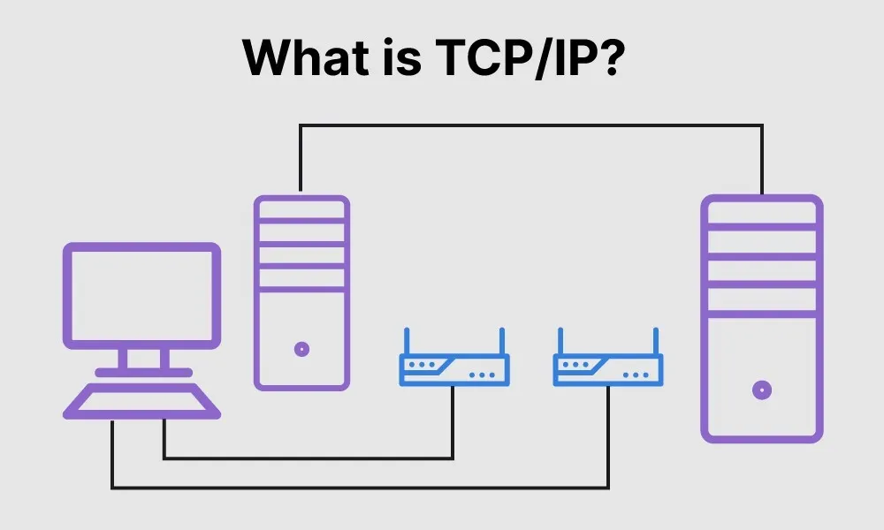
Introduction

Slide 3

Introduction

Slide 4
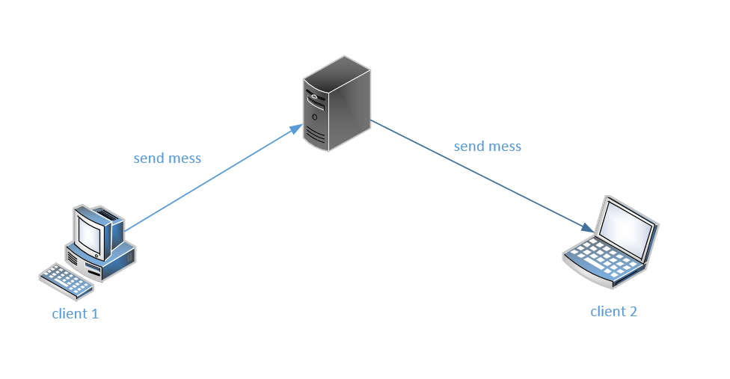
System Analysis

Slide 5
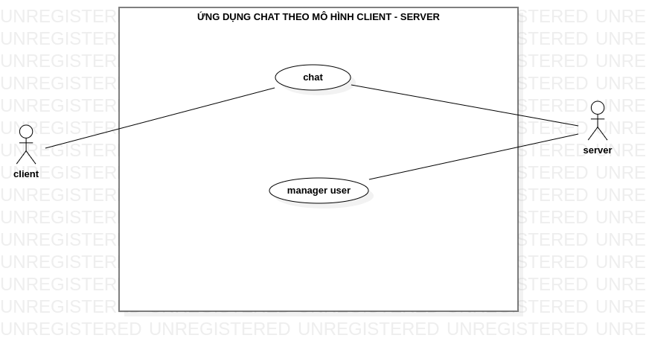
System Analysis

Slide 6
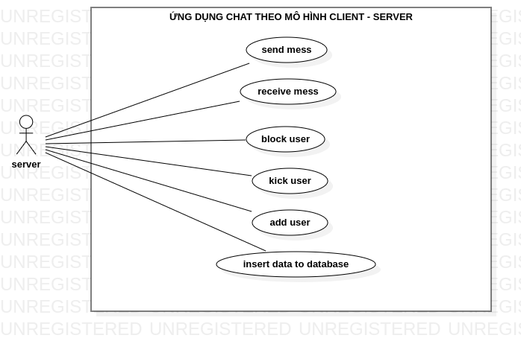
System Analysis

Slide 7
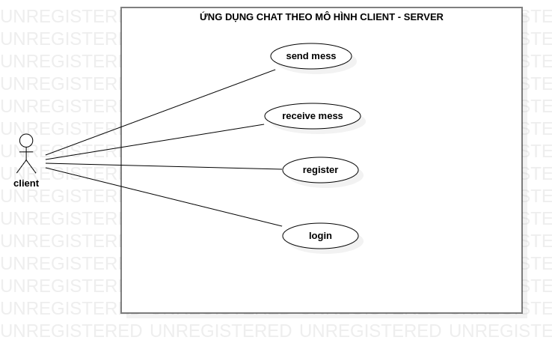
System Analysis

Slide 8
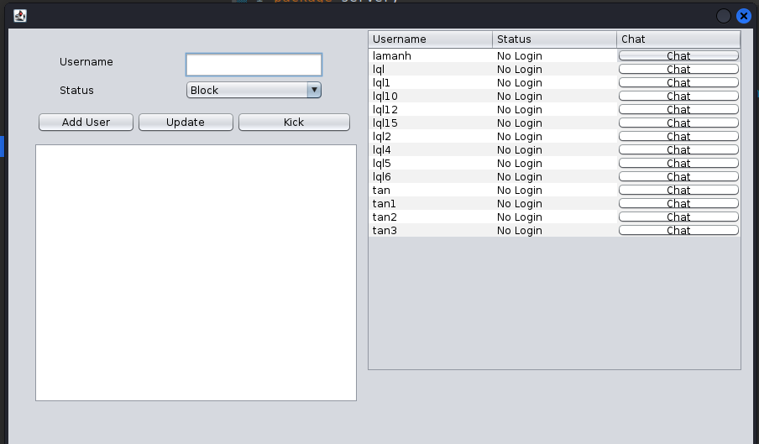
Demo

Slide 9
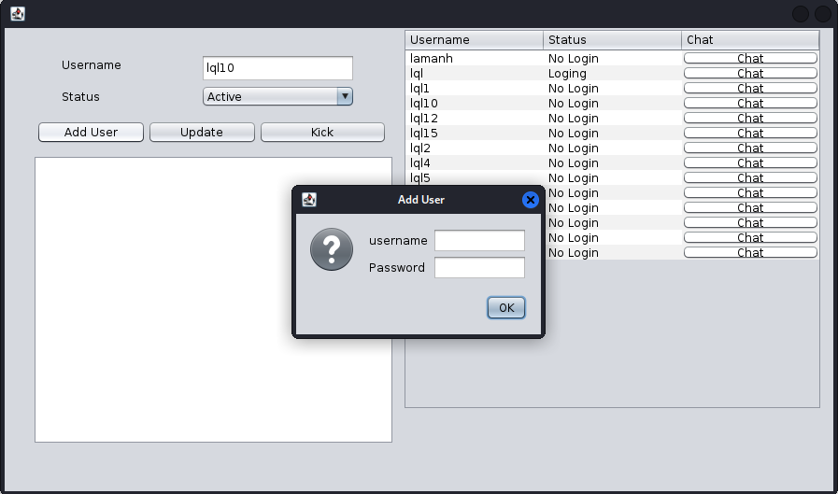
Demo

Slide 10
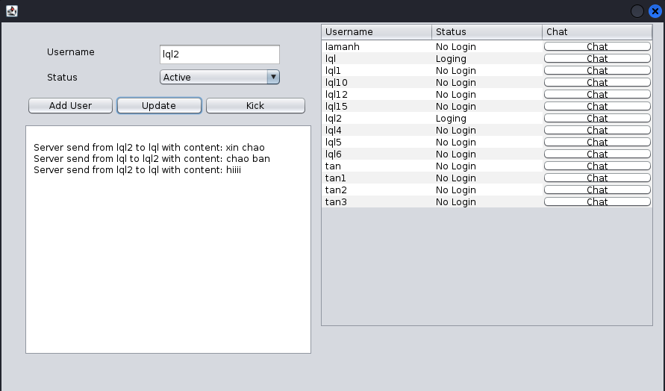
Demo

Slide 11
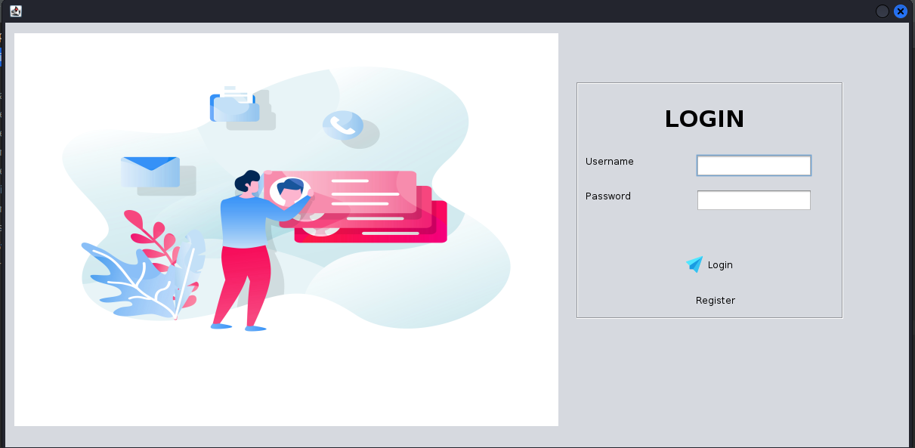
Demo

Slide 12
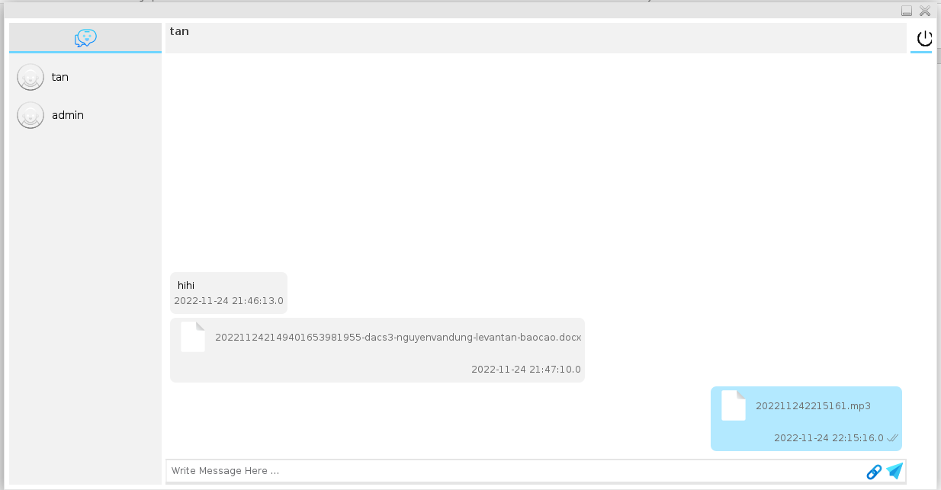
Demo

Slide 13
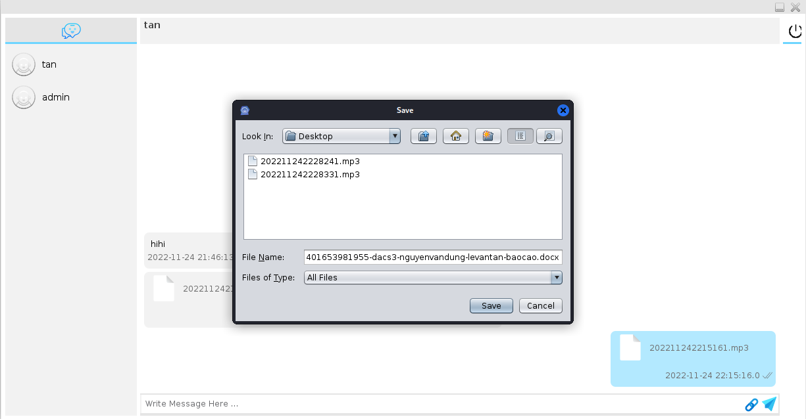
Demo

Slide 14


